Slide 1

Module 6 – Video 6
Two-Part Tariffs
Professor Nico Voigtländer
Management 405: Module 6

Slide 2
OUTLINE of module 6
Simple vs. complex pricing
Direct price discrimination
  Perfect price discrimination (first degree)
  Segment pricing (third degree)
Indirect price discrimination (second degree)
    Versioning
  Coupons
Advanced pricing strategies
  Flat fee pricing
  Two-part tariff
  Block pricing

Slide 3
Two part-Tariff
Now: MC>0
P
Flat fee ,F*, is equal to the entire consumer surplus. Usage fee, P*, is set equal to MC.
F*
P*
MC
D
Q

Slide 4
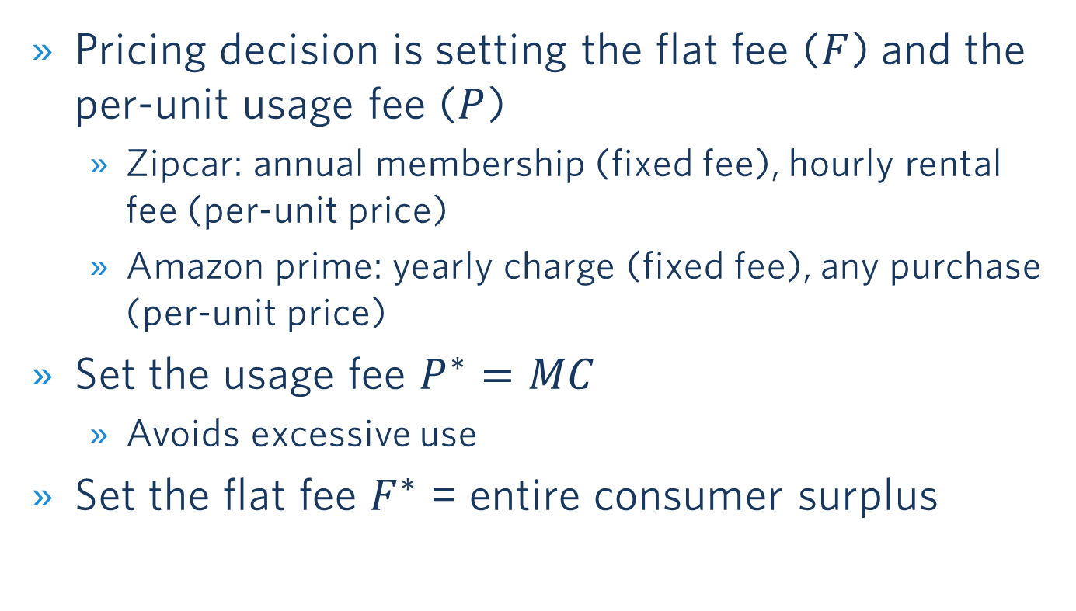
Two-part tariff
Summary
Pricing decision is setting the flat fee ($F$) and the per-unit usage fee ($P$)
  Zipcar: annual membership (fixed fee), hourly rental fee (per-unit price)
  Amazon prime: yearly charge (fixed fee), any purchase (per-unit price)
Set the usage fee $P^{∗}=MC$
  Avoids excessive use
Set the flat fee $F^{∗}$ = entire consumer surplus

Slide 5

Two-Part Tariff: ZipCar
P
Two-part tariff:
  Flat fee: F =$50
  Usage fee: P =$0.5/mile
Would a flat fee (P =0) be a good idea?
  No, it would lead to excessive use
$1.50
$$P=1.5−0.01Q$$
Flat fee
=$(1.5-0.5) ∙100/2
=$50
MC
$0.50
Per-mile usage fee
=$0.5∙100 = $50
D
100
150
Q (miles per year)

